Slide 1



This project has received funding from the European Union’s Horizon 2020 research and innovation programme under grant agreement no. 688467
Towards Semantic Interoperability in WoT Ecosystems
Andrea Cimmino, María Poveda-Villalón, Raúl García-Castro
Ontology Engineering Group
Universidad Politécnica de Madrid, Spain
cimmino@fi.upm.es
Notes:
Cambiar la licencia por la que aplique.

Slide 2




The Web of …

Slide 3
The Web of Heterogeneities
Heterogeneus Access
REST API
Database
REST API
File storage

Slide 4
The Web of Heterogeneities
Heterogeneus Access
Heterogeneus Formats
REST API
Database
JSON
CSV
REST API
File storage
XML
JSON

Slide 5
The Web of Heterogeneities
Heterogeneus Access
Heterogeneus Formats
Heterogeneus Models
REST API
{ ”cold" : 268.15,
“Kw” : 8,
“Kw/€” : 50
“objects” : 10
}
time,value
00:20, 12.29
00:25, 12.30
00:30, 12.28
Database
JSON
CSV
{ "tmp" : "-2ºC",
"power" : "10Kw",
”content": [
{ "type" : "apple"},
{ "type" : "apple"},
{ "type" : "orange"},
...
] }
<caption>
<value> 3 </value>
</caption>
REST API
File storage
XML
JSON

Slide 6
Index
Bringing Semantic Interoperability
The WoT-Mappings
Semantic Interoperability Services
Conclusions

Slide 7
Bringing Semantic Interoperability
{ "tmp" : "-2ºC",
"power" : "10Kw",
”content": [
{ "type" : "apple"},
{ "type" : "apple"},
{ "type" : "orange"},
...
] }
File storage
Heterogeneity:
JSON
Heterogeneus Access
Heterogeneus Formats
Heterogeneus Models

Slide 8
Bringing Semantic Interoperability
REST API
Syntactic Interoperability:
RDF
Homogeneus Access
Homogeneus Format
Heterogeneus Models
{ "tmp" : "-2ºC",
"power" : "10Kw",
”content": [
{ "type" : "apple"},
{ "type" : "apple"},
{ "type" : "orange"},
...
] }
File storage
Heterogeneity:
JSON
Heterogeneus Access
Heterogeneus Formats
Heterogeneus Models

Slide 9
Bringing Semantic Interoperability
REST API
saref
Syntactic Interoperability:
RDF
WoT
Homogeneus Access
Homogeneus Format
Heterogeneus Models
sosa
…
REST API
Syntactic Interoperability:
RDF
Homogeneus Access
Homogeneus Format
Heterogeneus Models
{ "tmp" : "-2ºC",
"power" : "10Kw",
”content": [
{ "type" : "apple"},
{ "type" : "apple"},
{ "type" : "orange"},
...
] }
File storage
Heterogeneity:
JSON
Heterogeneus Access
Heterogeneus Formats
Heterogeneus Models

Slide 10
Overcoming heterogeneity
Service
Heterogeneus
Access,
Format, Model
<<exposes data>>
Model₁
Datastore

Slide 11

Overcoming heterogeneity
WoT
Mappings
WoT
Service
Heterogeneus
Access,
Format, Model
<<described by>>
<<exposes data>>
Model₁
Datastore

Slide 12
Overcoming heterogeneity
SPARQL
Resources
Dataset
Homogeneus
Access,
Format, Model
Client
<<reads>>
<<reads>>
<<reads>>
WoT
Mappings
WoT
Service
Heterogeneus
Access,
Format, Model
<<described by>>
<<exposes data>>
Model₁
Datastore

Slide 13
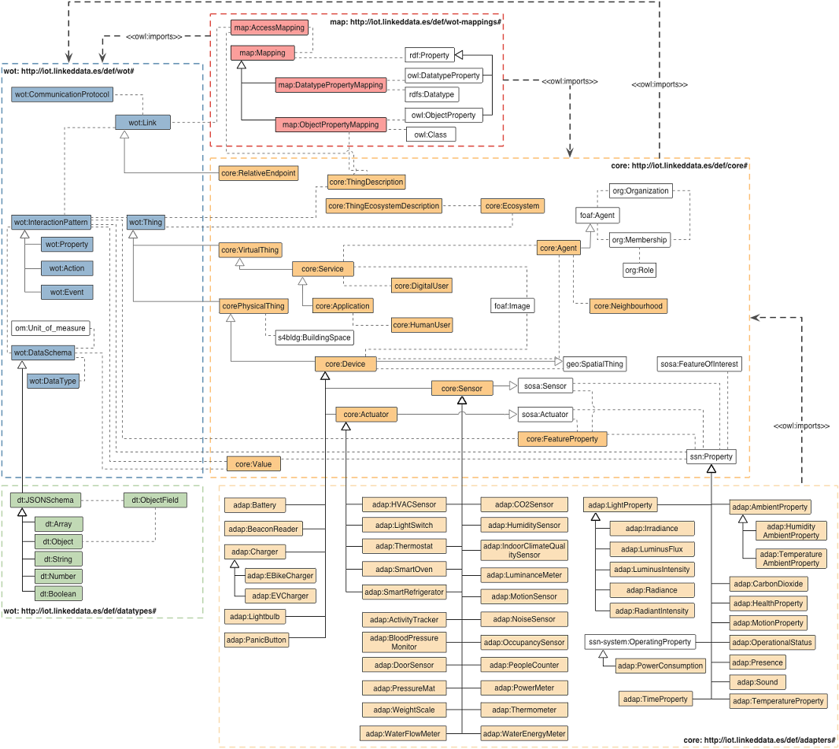

Ontology overview
WoT mappings
Web of Things
VICINITY Core
Data
types
VICINITY Adapters
07-VICINITY Ontology
Slide 7

Slide 14
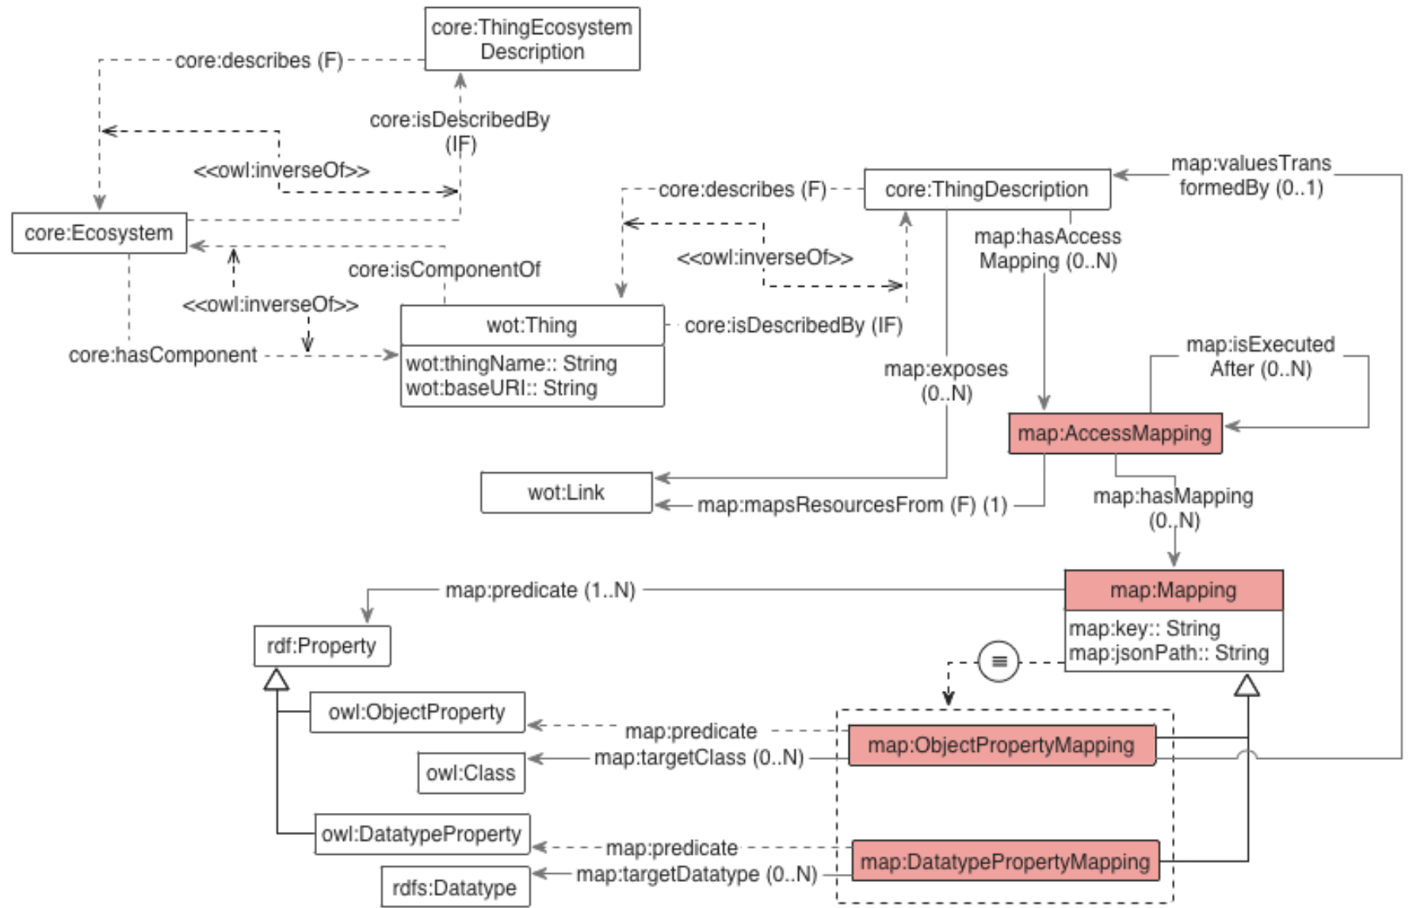
The WoT-Mappings

Slide 15
Semantic Interoperability Services: Registering “Things”
<<described by>>
<<stored at>>
Description Repository
…
<<described by>>
<<stored at>>
Description content:
<<described by>>
<<stored at>>
- Description
- Contextual data
- Mappings
<<described by>>
<<stored at>>
How to translate non-RDF data into
RDF

Slide 16

Semantic Interoperability Services: Discovery “Things”
If query does not require to access data, the answer is provided
Agent
Query
Results
2
1
Client
Discovery
Services
4
<<discovery>>
Only suitable descriptions are retrieved in the discovery
3
Description Repository
…

Slide 17
Semantic Interoperability Services: Distributed access to “Things”
After discovery, Things endpoints are retrieved and accessed
Query
Results
Description and fetched data are combined to answer the query
Agent
1
3
Client
Only suitable endpoints are accessed
<<access>>
2
Homogeneus Access
Homogeneus Format
Homogeneus Model
Endpoint 1
Endpoint 2
…
Endpoint 3

Slide 18
Semantic Interoperability Services: Distributed access to “Things”
Translates fetched data into RDF using mappings
After discovery, Things endpoints are retrieved and accessed
Agent
Query
Results
1
4
3
Client
<<access>>
2
Only suitable endpoints are accessed. Thus the Client implements mechanisms to overcome the heterogeneous access of endpoints (specified in mappings)
Heterogeneus Access
Heterogeneus Formats
Heterogeneus Models
Endpoint 1
Endpoint 2
…
Endpoint 3

Slide 19
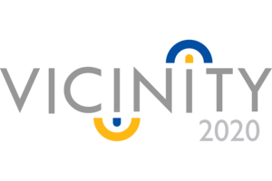

WoT in our research
Projects:
Specifications:
WoT-Mappings
Impementations:
WoT-Implementation
Helio
(mapping processor)

Slide 20
Conclusions of our approach
Allows to transparently discover Things relaying on their descriptions
Performs a distributed access, if required, only to the suitable endpoints to answer a query
Provides a transparent mechanism to interact with heterogeneous environments of data
Mapping-based normalisation of access points, format, model
May follow any of the privacy policies required
Supports centralised or decentralised architectures
Based on WoT + WoT-mappings ontology
Plus other ancillary ontologies like core, adapters, saref, …

Slide 21

Thanks to all
Achieving interoperability is not only about descriptions, but also about providing mechanisms for automatic data discovery and access from heterogeneous data sources

